Slide 1
CND111: Introduction to Digital Design

Slide 2
Lab 7: Convolutional Encoder

Slide 3
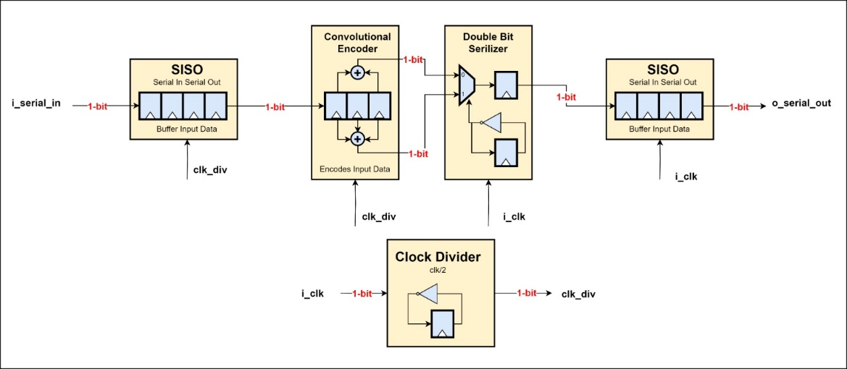
You’re required to design the block shown below:

Slide 4
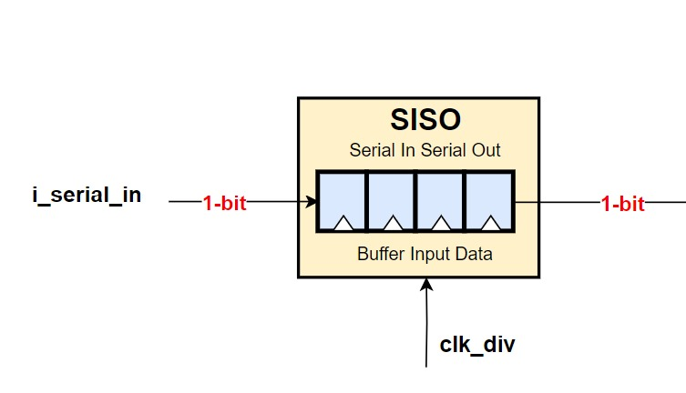
Specification
The serial-in-serial-out shift register takes the input serially and does the shifting operation as shown in the figure below:

Slide 5
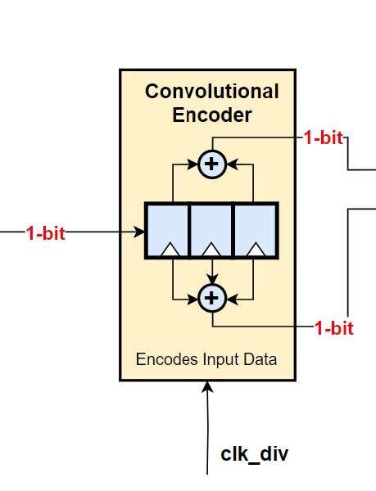
Specification
The convolutional encoder is a simple 3-bit shift register that takes the external input serially and does the shifting operation and based on the figure below, it computes its two outputs:

Slide 6
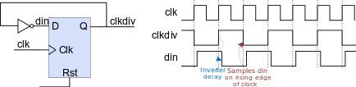
Specification
The clock divider takes the input clock and divides it by 2 to generate a slower clock. The slower clock is provided to the SISO at the input side as well as the SISO at the output side and the conv encoder.

Slide 7
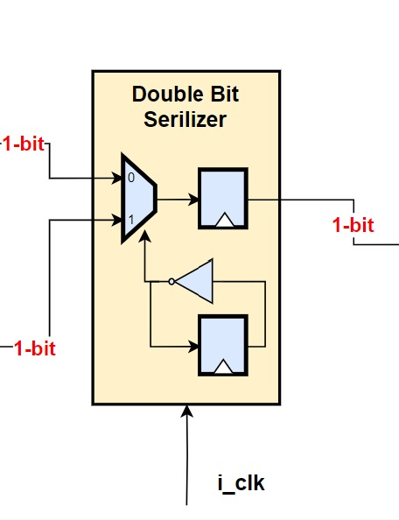
Specification
The Double-bit synchronizer takes the two parallel outputs of the conv encoder, and serializes them to be appearing on a single serial wire.

